Slide 1




NEXT GEN EMPLOYABILITY PROGRAM
Creating a future-ready workforce
Team Members
College Name
Student Name : AKILAN S
Student ID :623521104001
AVS College of Technology

Slide 2

CAPSTONE PROJECT SHOWCASE
Project Title
Building Bus Reservation System using Python and Django
Abstract | Problem Statement | Project Overview | Proposed Solution | Technology Used | Modelling & Results | Conclusion

Slide 3
Abstract
The Bus Reservation System using Python and Django provides a user-friendly platform for booking bus tickets, managing reservations, and accessing route information. Key features include user management, bus and route management, booking with real-time updates, payment integration, ticket management, notifications, and reporting. Leveraging Python and Django ensures rapid development, scalability, and reliability, promising to revolutionize the bus booking experience.
Source : https://projectworlds.in/bus-reservation-system-project-python-django

Slide 4
Problem Statement
Background : Current bus booking systems often lack efficiency and convenience, leading to user dissatisfaction and operational challenges. There is a pressing need for a user-friendly and efficient Bus Reservation System.
Problem Description : Develop a Bus Reservation System using Python and Django to address the following challenges:
Cumbersome booking processes. Inefficient management of buses, routes, and schedules. Security vulnerabilities in transactions and data handling. Limited reporting capabilities for data-driven decision-making.
Objectives : Simplify bus booking processes with an intuitive. Enable efficient management of buses and schedules for administrators. Ensure secure transactions and data handling. Provide comprehensive reporting for informed decision-making.
Source :

Slide 5
Project Overview
Building a web-based bus reservation system using Python and Django framework. Explain the purpose of the system: To facilitate users in booking bus tickets online, managing reservations, and providing administrative tools for bus operators.
Features:
User Registration and Authentication: Allow users to register and log in securely.
Bus Search and Booking: Users can search for available buses based on criteria like date, time, origin, and destination, and book tickets for their desired routes.
Seat Selection: Users can select seats from the available ones on the chosen bus.
Payment Integration: Integrate payment gateways for secure online transactions.
Ticket Confirmation: Users receive a confirmation email or message after successful booking.
Admin Panel: Provide an administrative interface for bus operators to manage bus schedules, seat availability, and view reservations.
Source :

Slide 6
Proposed Solution
A bus reservation system is a mobile or web software solution designed to provide customers with a personalized easy-to-utilize user experience for booking and purchasing tickets online. It stores customers' personal data records, scheduled routes, frequent trips, drop points, and other information.
Source :

Slide 7


Technology Used
Front-end
Back-end
Source :

Slide 8
Modelling & Results
User Management: Handle user registration, login, and profile management.
Bus Management: CRUD operations for bus schedules, routes, and seat availability.
Booking Management: Process bookings, manage reservations, and handle cancellations.
Payment Gateway Integration: Securely process payments for ticket bookings.
Reporting: Generate reports for administrators on sales, bookings, etc.
Source :

Slide 9
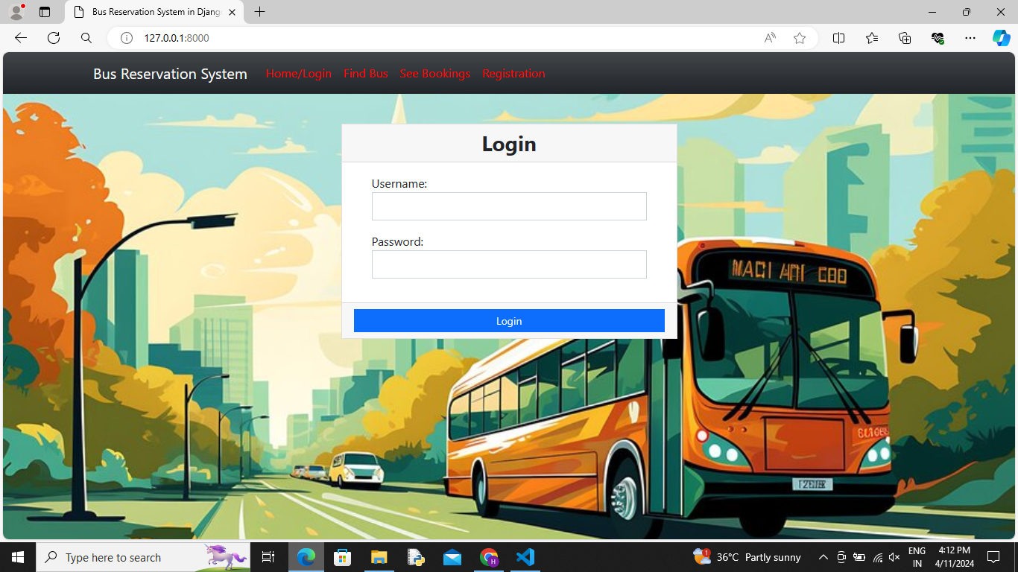
Homepage

Slide 10
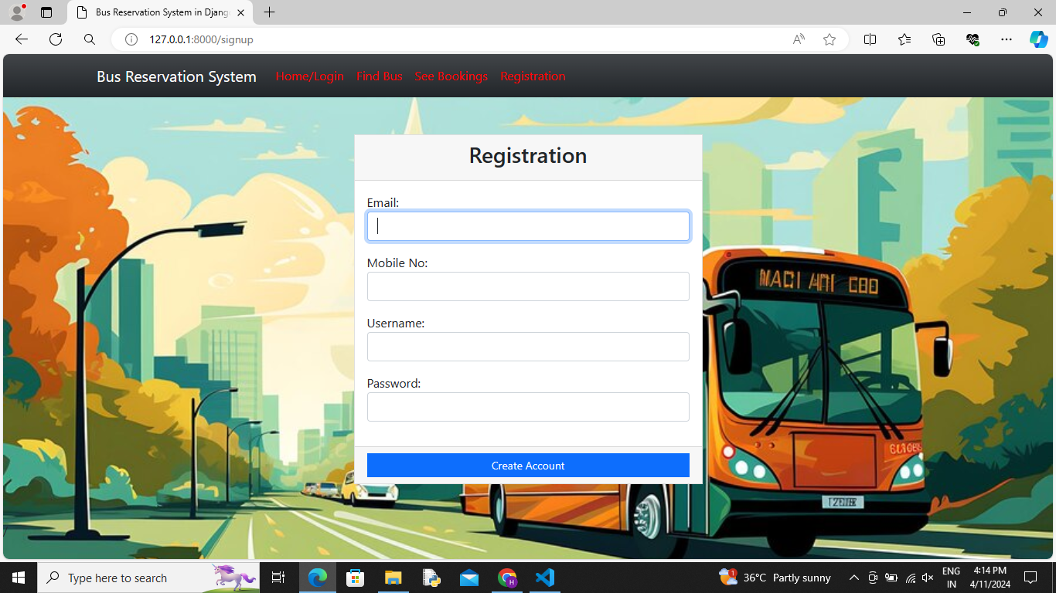
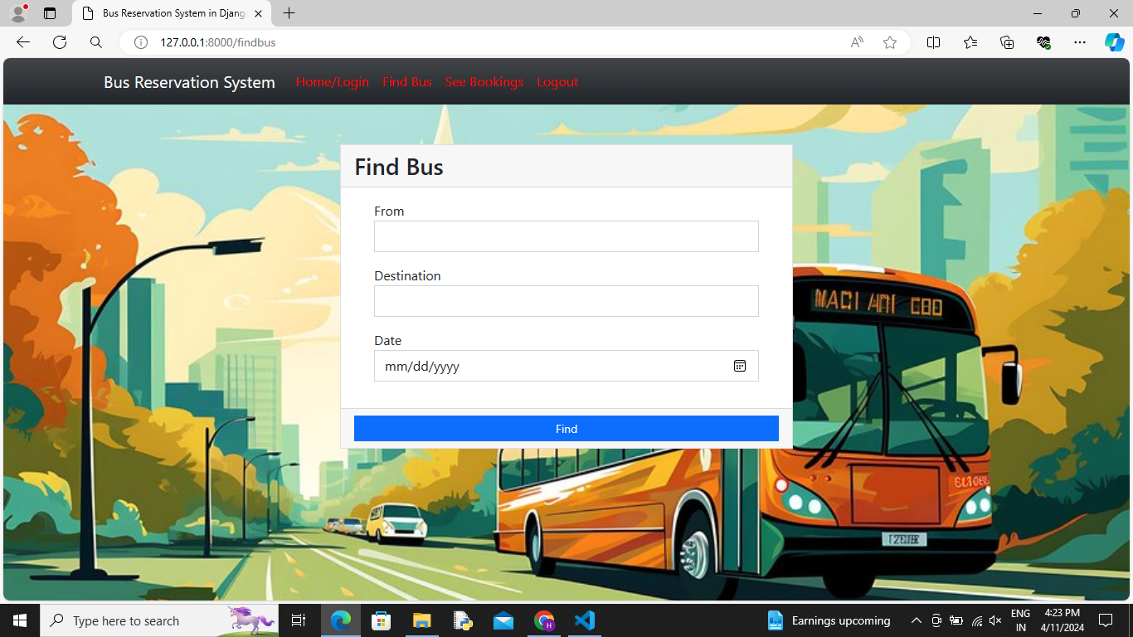
Service-Page
Registration Page
Login Page
Find Bus

Slide 11
Future Enhancements:
Integration with third-party APIs for real-time bus tracking and route information.
Mobile app development for a more convenient booking experience.
Implementing seat selection based on bus layout visualization.
Enhancing user experience with personalized recommendations and offers.

Slide 12
Conclusion
Summarize the project goals and the benefits it brings to users and bus operators.
Highlight the significance of online bus reservation systems in today's digital age.
Source :

Slide 13
Thank You!
Notes:
Thank You !!

